Slide 1
F&VP12
Introduction to Film Language:
Mise En Scene

Slide 2
Session Aims
By the end of the session you will be able to:
Understand the concept of ‘mise en scene’
Apply the concept to a film extract

Slide 3
Definition: Mise En Scene
A French term meaning what is put into a scene or frame
Visual information in front of the camera
Communicates essential information to the audience
Made up of 5 elements: Can you guess what they are?

Slide 4
The 5 Elements of Mise en Scene
Each aspect of mise-en-scene has hidden meanings within a film and sends signals to the audience about how we are supposed to feel at a certain point
Settings & Props
Costume, Hair & Make Up
Facial Expressions & Body Language
Lighting & Colour
Positioning of characters/objects within the frame

Slide 5
1. Settings & Props
Settings & Locations play an important part in film-making and are not just ‘backgrounds’
Sets are either built from scratch or a great deal of time is spent to find a setting which already exists
Settings can manipulate an audience by building certain expectations and then taking a different turn
TASK: What settings and props you would find in:
A Science Fiction Film
A Romantic Comedy
A Horror Film

Slide 6
2. Costume, Hair & Make Up
Costume, Hair & Make Up act as an instant indicator to us of a character’s personality, status & job
It tells us immediately whether the film is set in the present and what society/or culture it will centre around
Certain costumes can signify certain individuals (i.e. black cloak of a vampire, Spidey’s Spiderman suit)

Slide 8
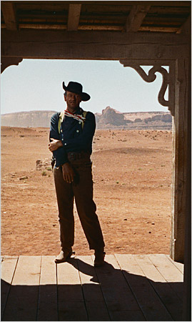

Slide 9
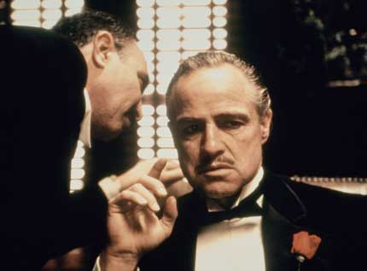

Slide 10
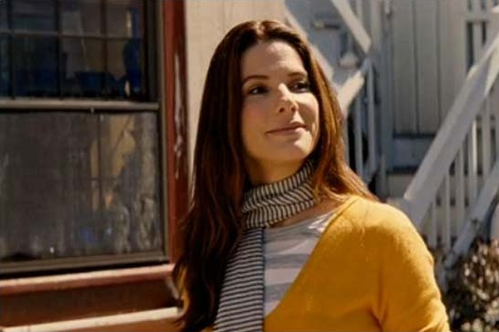

Slide 11
3. Facial Expressions & Body Language
Facial Expressions provide a clear indicator of how someone is feeling
If someone is smiling broadly, we assume they are happy but we may get a different feeling if this is accompanied by scary music
Body Language may also indicate how a character feels towards another character or may reflect the state of their relationship
TASK: What meanings/emotions do the following images convey:

Slide 12
IMAGE 1

Slide 13
IMAGE 2

Slide 14
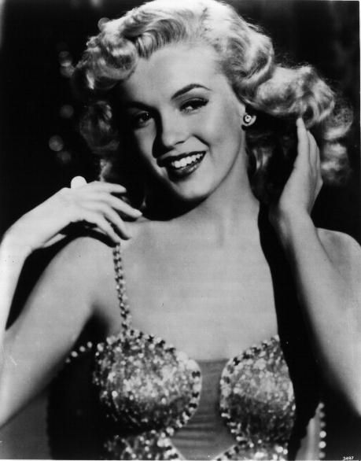
IMAGE 3

Slide 15
4. Positioning of Characters & Objects within a frame
Positioning within a frame can draw our attention to an important character/object
A film-maker can use positioning to indicate relationships between people
TASK: What does the positioning in the following images reveal about the characters/film:

Slide 16
IMAGE 1

Slide 17
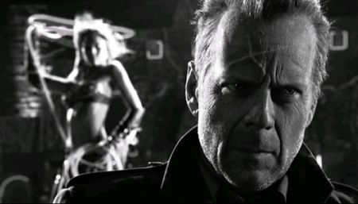
IMAGE 2

Slide 18
IMAGE 3

Slide 19
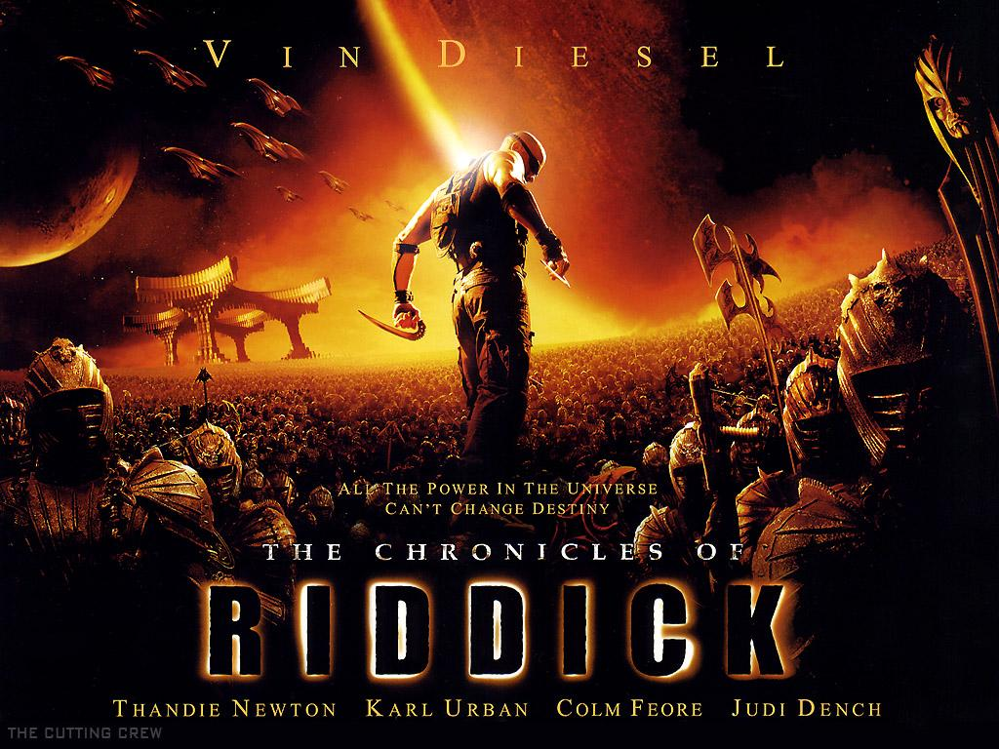
IMAGE 4

Slide 20
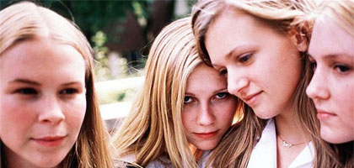
Colour
Colour carries certain connotations which may add meaning to a scene (i.e. Red = Danger/Passion)
Can give a scene a particular look, feel or mood
Can be used for dramatic effect

Slide 21
5. Lighting & Colour
Lighting & Colour can be used to achieve a variety of effects:
To highlight important characters or objects within the frame
To make characters look mysterious by shading sections of the face & body
To reflect a characters mental state/hidden emotions (i.e. bright = happy, dark = disturbed, strobe effect = confused

Slide 22
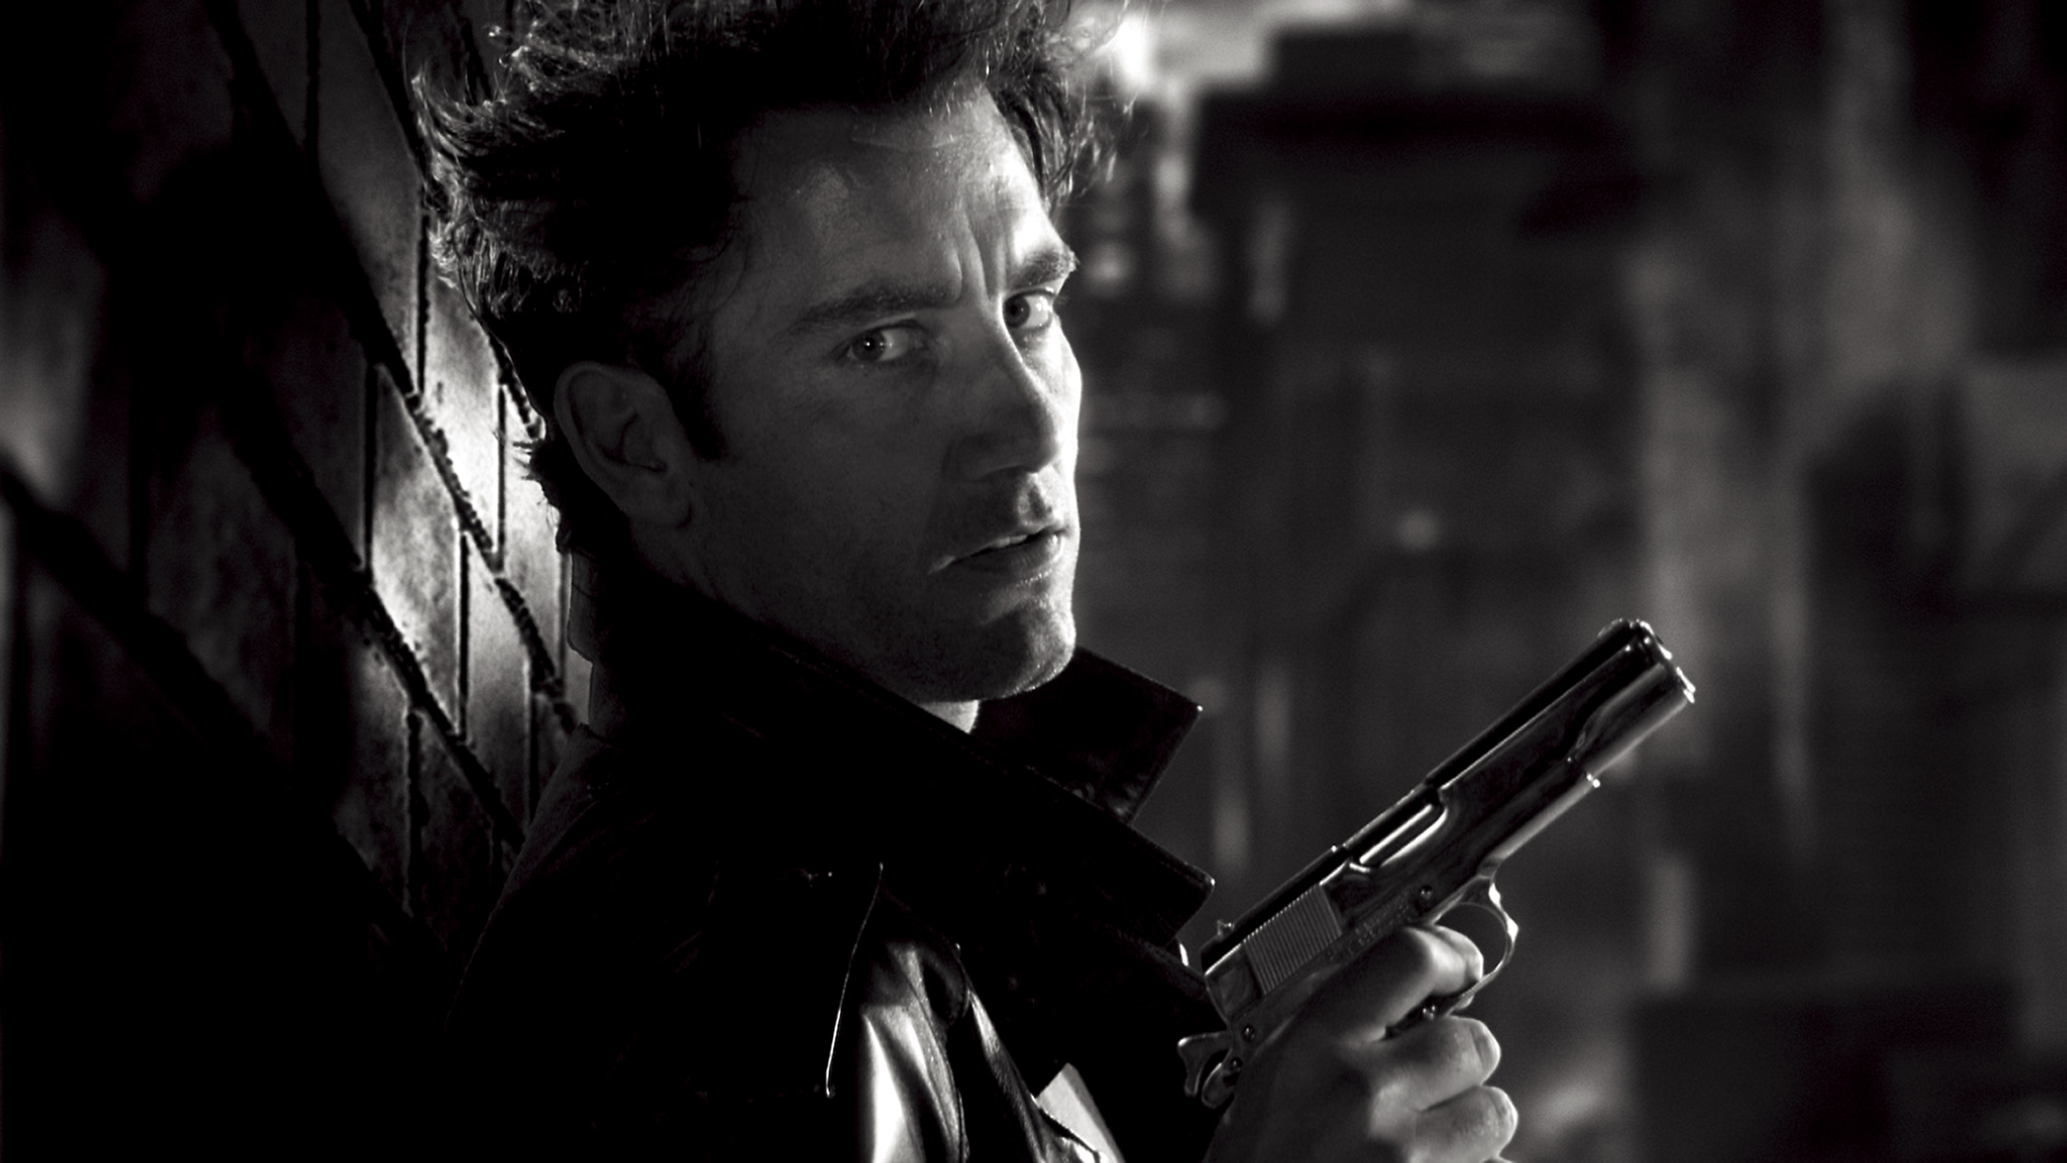
Types of Lighting
LOW KEY LIGHTING:
Created by using only the key & back lights
Produces sharp contrasts of light and dark areas
Deep, distinct shadows/silhouettes are formed
Example: Horror Films

Slide 23
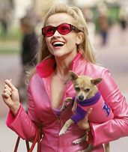
Types of Lighting
HIGH KEY LIGHTING:
More filler lights are used. Lighting is natural and realistic to our eyes
Produces brightly lit sets or a sunny day (right)
Example: Rom-Coms

Slide 24
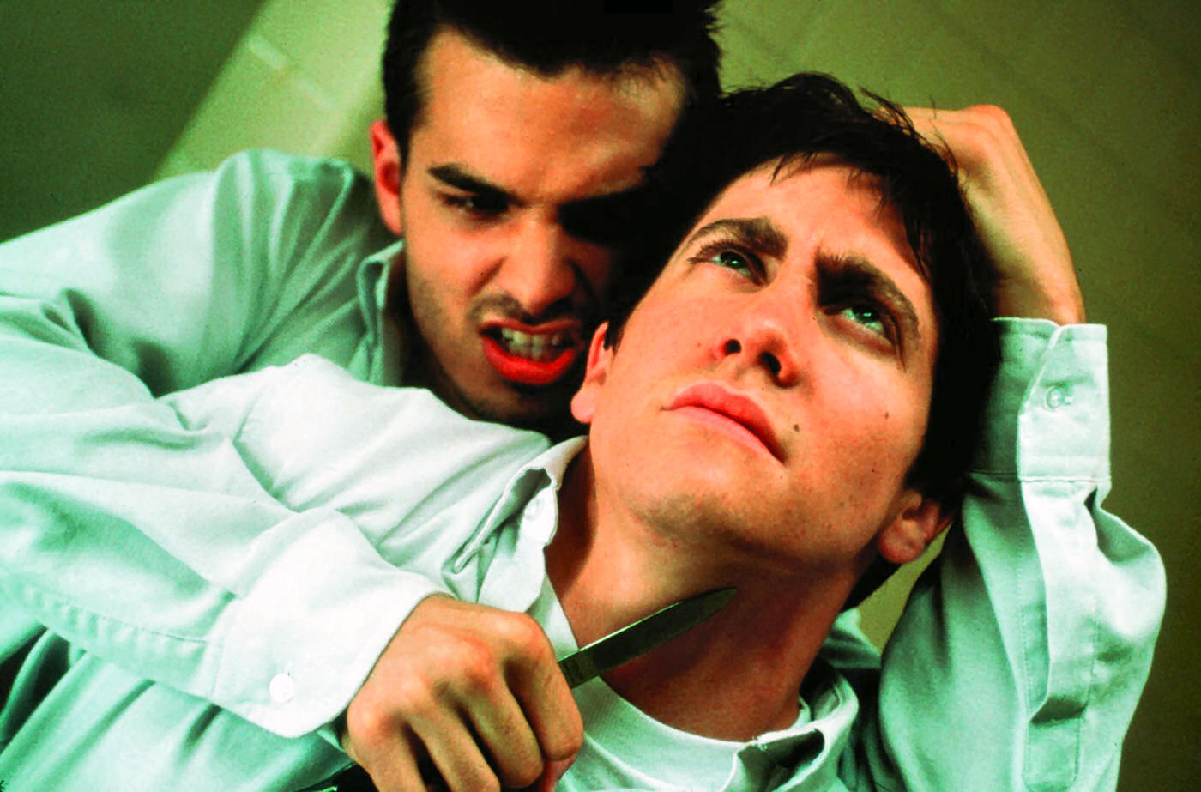
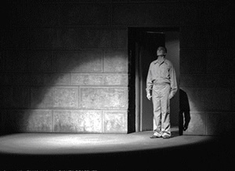
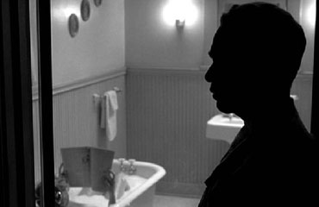
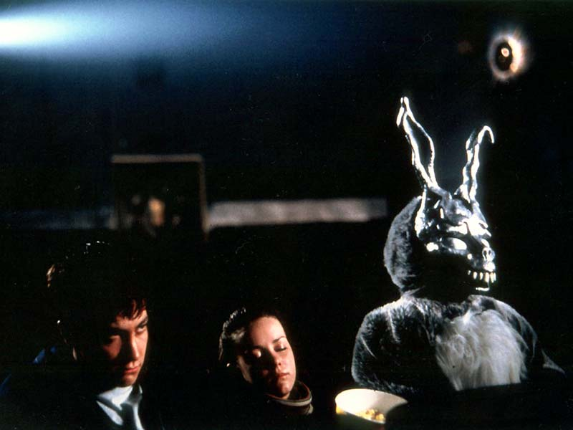
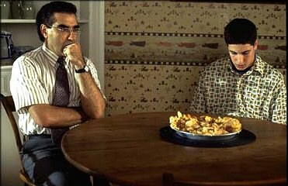
What types of lighting are used in the following images:
A
B
C
D
E
F

Slide 25
TASK: For each image, answer the following questions:
What type of lighting is used in each image (High or Low Key)?
Where are the KEY LIGHTS, FILLER LIGHTS & BACK LIGHTS in each image?
What effects/meanings does the lighting suggest?

Slide 26
Analysing Mise en Scene

Slide 27
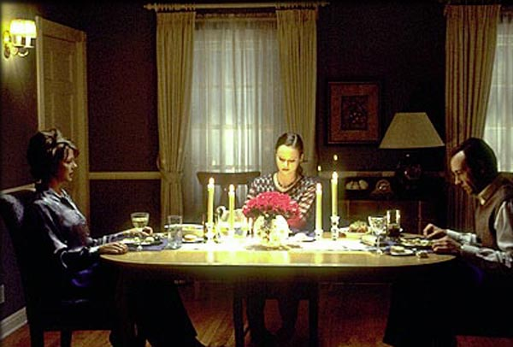
BACK
LIGHT
FILLER LIGHTS
KEY LIGHT

Slide 28
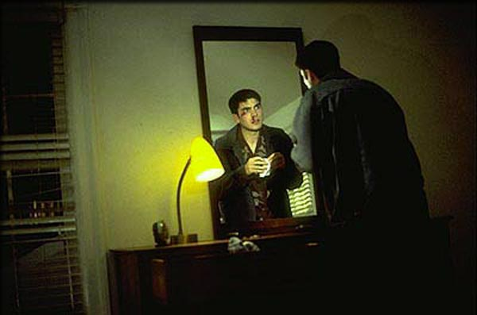

Slide 29
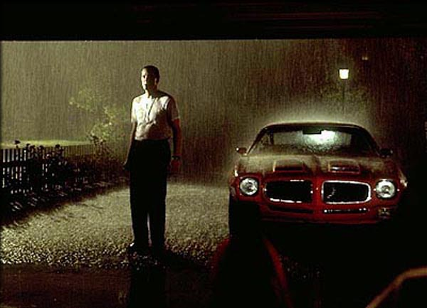

Slide 30
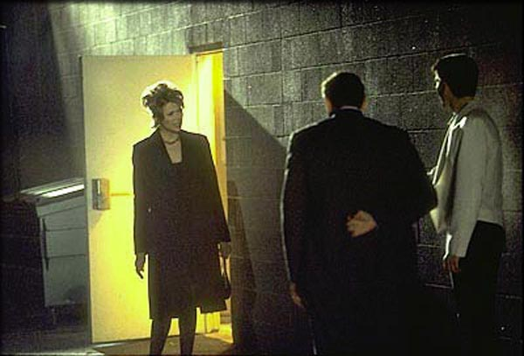

Slide 31
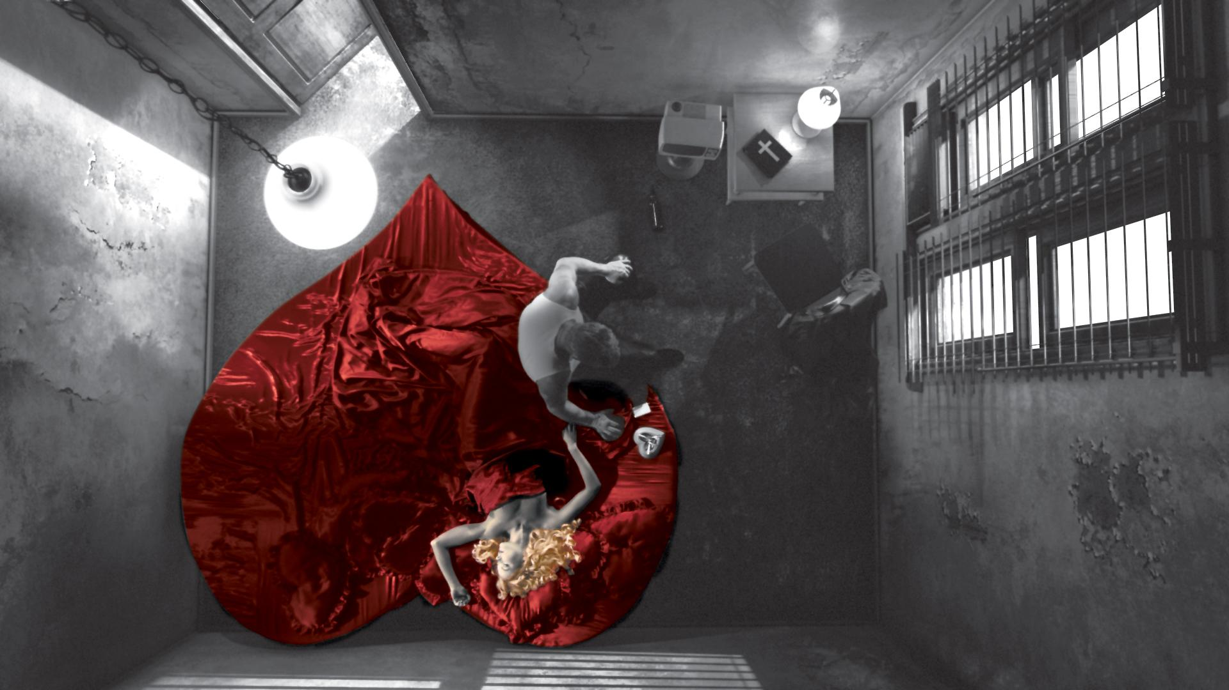

Slide 32
Analyse a sequence
When we analyse a sequence in terms of mise en scène, we need to look at how all the different elements and techniques work together to:
Tell a story
Evoke an atmosphere
Give the audience information
Provoke an audience response
Highlight key themes

Slide 33
ACTIVITY
Imagine a room . How would you decorate it and what would you put in it to suggest the following inhabitants:
1. A poor and destitute couple in the 17th Century
2. A middle-class couple in the 1940s
3. A spy in the year 2012
4. A businessman in 2012
5. A business woman 2012
6. A group of students

Slide 34
Ghost World directed by Terry Zwigoff (2001)

Slide 35
The Dominant
Where is our eye attracted first? Why?
The dominant contrast can be created by any number of techniques. The size of an object may draw our attention to it. In black and white movies, the dominant contrast is generally achieved through a juxtaposition of lights and darks. In color films, the dominant is often achieved by having one colour stand out from the others. Placing one object in sharper focus than the rest of the shot can also create a dominant contrast a dominant.

Slide 36
The dominant in this shot is the character of Enid (Thora Birch).
The dominant is created by:
Size. She's one of the two largest objects in the shot.
Focus. She's one of the two objects in focus.
Lighting. Unlike Seymour (Steve Buscemi), who's also large and in focus, Enid is highlighted by a shaft of light.
Colour. Enid wears a bright blue top while the rest of the shot is composed of variations of brown.

Slide 37
Lighting Key
High key? Low key? High contrast? Some combination of these?
High key lighting--features bright, even illumination and few conspicuous shadows. This lighting key is often used in musicals and comedies.
Low key lighting--features diffused shadows and atmospheric pools of light. This lighting key is often used in mysteries and thrillers.
High contrast lighting--features harsh shafts of lights and dramatic streaks of blackness. This type of lighting is often used in tragedies and melodramas.

Slide 38
The lighting key in this shot is moderate. The scene is not brightly lit, but there isn't a lot of shadows either. Also, there isn't a great contrast between lights and darks in the shot. Moderate lighting fits the genre, a character-based comedy/drama. It's not as bright as a light comedy, as dark as a thriller, or as dramatic as a tragedy or melodrama.

Slide 39
Shot and Camera Proxemics
What type of shot? How far away is the camera from the action?
Shots are defined by the amount of subject matter that's included within the frame. They can be divided into six basic categories:
Extreme long shot--taken from a great distance, showing much of the locale. If people are included in these shots, they usually appear as mere specks.
Long shot--corresponds to the space between the audience and the stage in a live theater. The long shots show the characters and some of the locale.
Full shot--range with just enough space to contain the human body in full. The full shot shows the character and a minimal amount of the locale.
Medium shot--shows the human figure from the knees or waist up.
Close-up--concentrates on a relatively small object and show very little if any locale.
Extreme close-up--focuses on an unnaturally small portion of an object, giving that part great detail and symbolic significance.

Slide 40
This shot is a medium shot. The two characters are shown from the thighs up.

Slide 41
Camera Angle
Are we (and the camera) looking up or down on the subject? Or is the camera neutral (eye level)?
There are five basic angles in film.
Bird's-eye view--the shot is photographed directly from above. This type of shot can be disorienting, and the people photographed seem insignificant.
High angle--this angle reduces the size of the objects photographed. A person photographed from this angle seems harmless and insignificant, but to a lesser extent than with the bird's-eye view.
Eye-level shot--the clearest view of an object, but seldom intrinsically dramatic, because it tends to be the norm.
Low angle--this angle increases high and a sense of verticality, heightening the importance of the object photographed. A person shot from this angle is given a sense of power and respect.
Oblique angle--for this angle, the camera is tilted laterally, giving the image a slanted appearance. Oblique angles suggest tension, transition, a impending movement. They are also called canted or dutch angles.

Slide 42
This shot is eye-level scene is not highly dramatic.
Signified: no power relationship is being suggested between the two characters

Slide 43
Colour Values
What is the dominant colour?
Are there contrasting foils?
Is there colour symbolism?

Slide 44
The use of colour in this shot is symbolic. The scene is set in Seymour's kitchen. Seymour's apartment, like Seymour himself, is very drab. Both the set and Seymour are dressed in browns.
Enid, on the other hand, is dressed in bright blue. She is not only a contrasting foil for Seymour and the shot, but she will metaphorically add some "colour" to his life.

Slide 45
Subsidiary Contrasts
After taking in the dominant, where does the eye go next?
What are the other main objects in the shot besides the dominant?

Slide 46
The main subsidiary contrast in this shot is Seymour. He doesn't stand out as much as Enid because his clothes blend in with the background and he doesn't have as much light on him as she does. However, his size is significant, and he's in focus. The other subsidiary contrast is the box in front of the couple. It's the only other object in focus.

Slide 47
Density
How much visual information is packed into the image?
Is the texture stark, moderate, or highly detailed?

Slide 48
Although there a lot of objects in the background, the
image is not very dense because the focus limits the viewer
to taking in only three main objects: Enid, Seymour, and
the box in front of them.

Slide 49
Framing
Is the framing tight or loose?
Do the character have no room to move around, or can they move freely without impediments?
Shots where the characters are placed at the edges of the frame and have little room to move around within the frame are considered tight.
Longer shots, in which characters have room to move around within the frame, are considered loose and tend to suggest freedom.

Slide 50
The framing in this shot is moderately loose. There seems to be a whole body width between the characters and the edges of the frame.

Slide 51
Character Placement
What part of the framed space do the characters occupy? Center? Top? Bottom? Edges? Why?
The area near the top of the frame can suggest ideas dealing with power, authority, and aspiration.
The areas near the bottom of the frame tend to suggest meanings opposite from the top: subservience, vulnerability, and powerlessness.
The left and right edges of the frame tend to suggest insignificance because these are the areas farthest removed from the center of the screen.

Slide 52
The characters are centered in the frame.
Signified: the important objects in this character-focused drama.

Slide 53
Staging Positions
Which way do the characters look vis-a-vis the camera?
An actor can be photographed in any of five basic positions, each conveying different psychological overtones.
Full-front (facing the camera): the position with the most intimacy. The character is looking in our direction, inviting our complicity.
Quarter Turn: the favored position of most filmmakers. This position offers a high degree of intimacy but with less emotional involvement than the full-front position.
Profile (looking of the frame left or right): More remote than the quarter turn, the character in profile seems unaware of being observed, lost in his or her own thoughts.
Three-quarter Turn: More anonymous than the profile, this position is useful for conveying a character's unfriendly or antisocial feelings, for in effect, the character is partially turning his or her back on us, rejecting our interest.
Back to Camera: The most anonymous of all positions, this position is often used to suggest a character's alienation from the world. When a character has his or her back to the camera, we can only guess what's taking place internally, conveying a sense of concealment, or mystery.

Slide 54
Both characters are shown in profile.
Signified: characters are focused on each other, not the outside world.

Slide 55
Character Proxemics
How much space is there between the characters?
The way people use space can be divided into four proxemic patterns.
Intimate distances: the intimate distance ranges from skin contact to about eighteen inches away. This is the distance of physical involvement--of love, comfort, and tenderness between individuals.
Personal distances: the personal distance ranges roughly from eighteen inches away to about four feet away. These distances tend to be reserved for friends and acquaintances. Personal distances preserve the privacy between individuals, yet these rages don't necessarily suggest exclusion, as intimate distances often do.
Social distances: the social distance rages from four feet to about twelve feet. These distances are usually reserved for impersonal business and casual social gatherings. It's a friendly range in most cases, yet somewhat more formal than the personal distance.
Public distances: The public distance extends from twelve feet to twenty-five feet or more. This range tends to be formal and rather detached

Slide 56
The distance in this shot is intimate,
Signified: the characters are good friends and are
comfortable with each other at this point in the film.

Slide 57
HOMEWORK
Pick a scene from a film (one that you can find a picture of on the internet) and do your own case study (similar to the one we have just done in class)
Hand in date:

