Slide 1
Storyboarding: from Ideas to Pictures

Slide 2
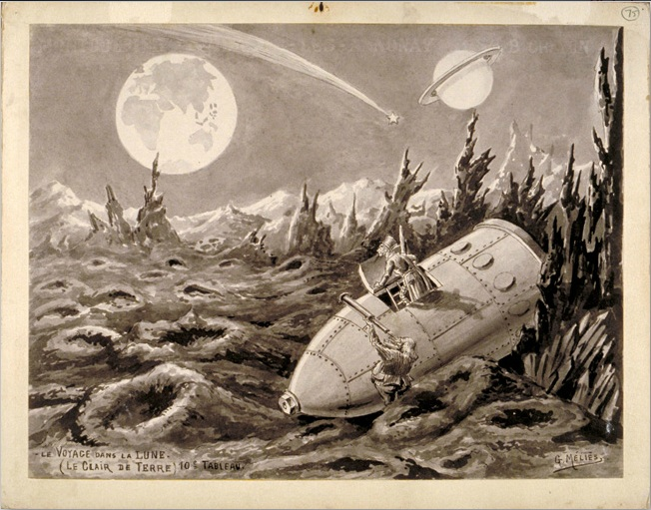
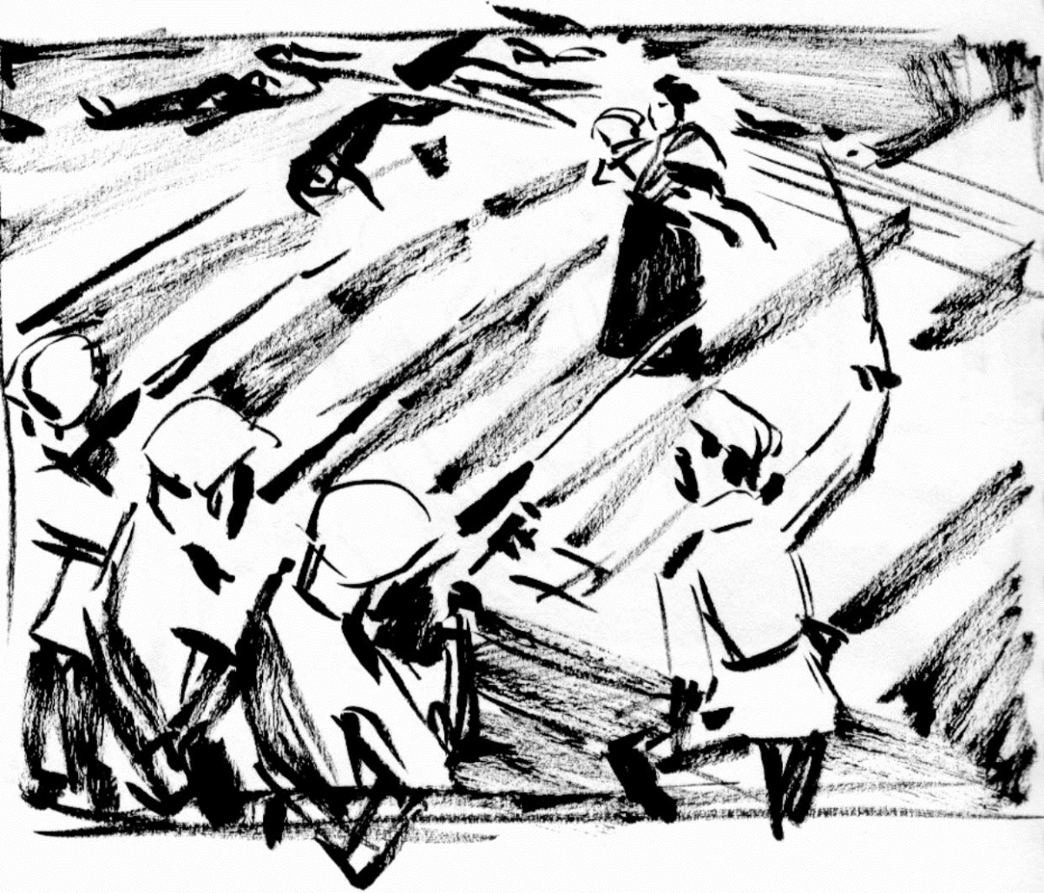
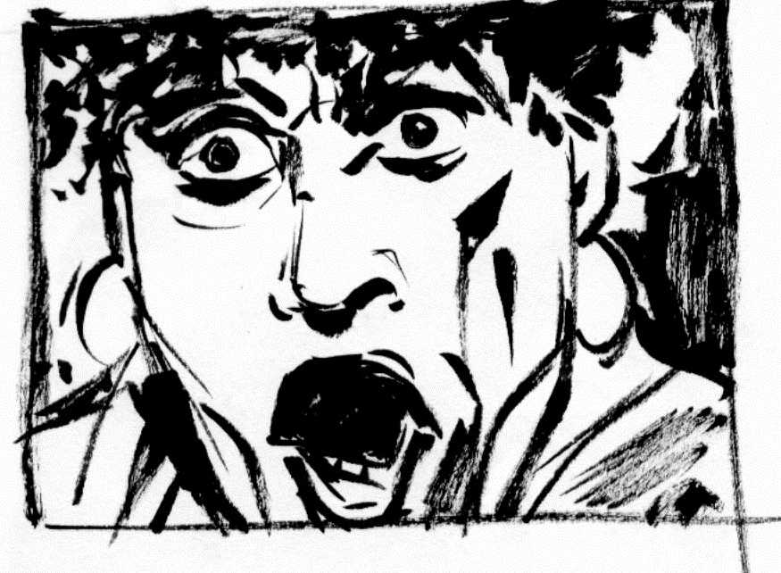
George Méliès, preliminary sketch for
Le Voyage dans la lune (1902)
S. Eisentein, preliminary sketches for The Battleship Potemkin (1925)

Slide 3
Storyboard “invented” by W. Disney in the 1930s

Slide 4
I. What is it?
A series of panels representing a shot-by-shot breakdown of a planned film.

Slide 5
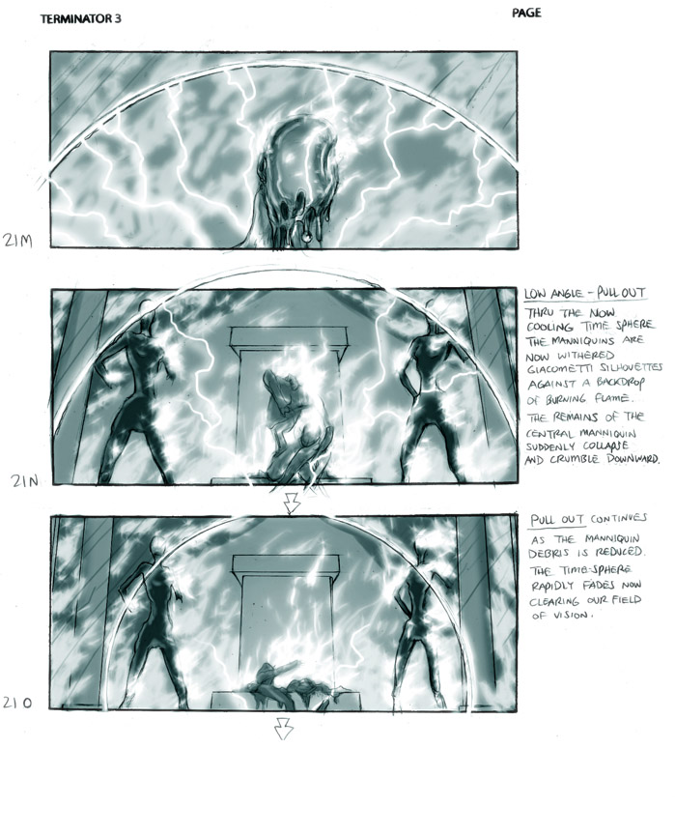
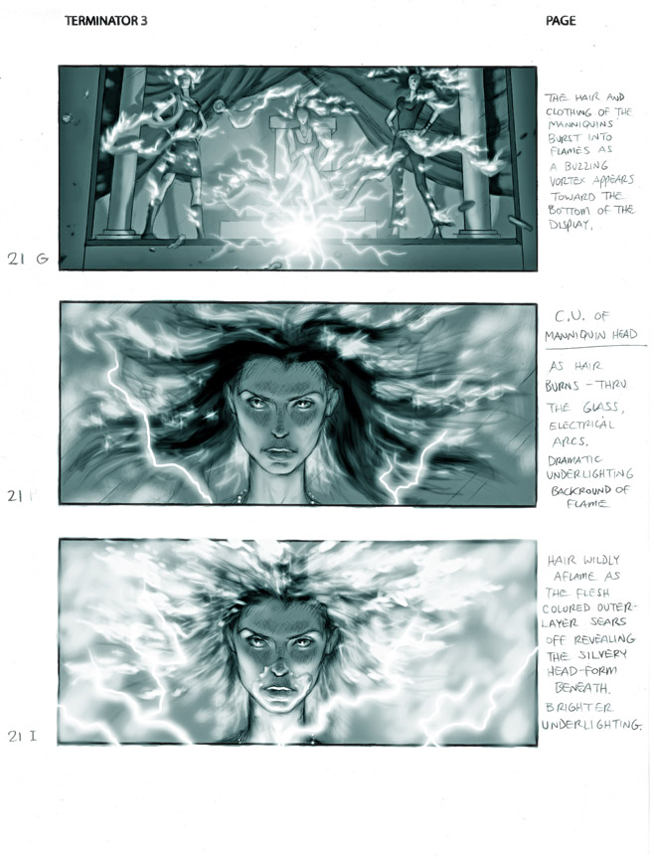
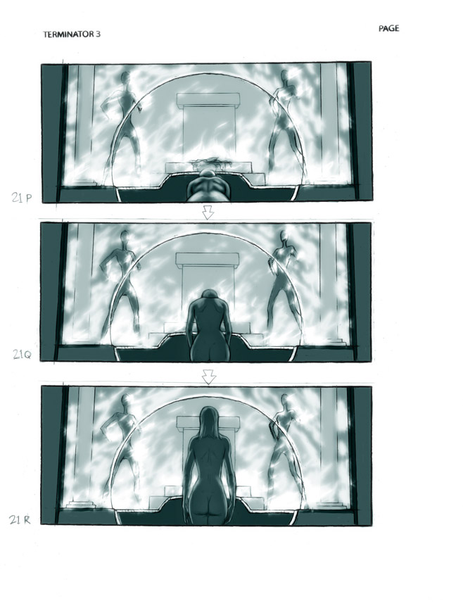
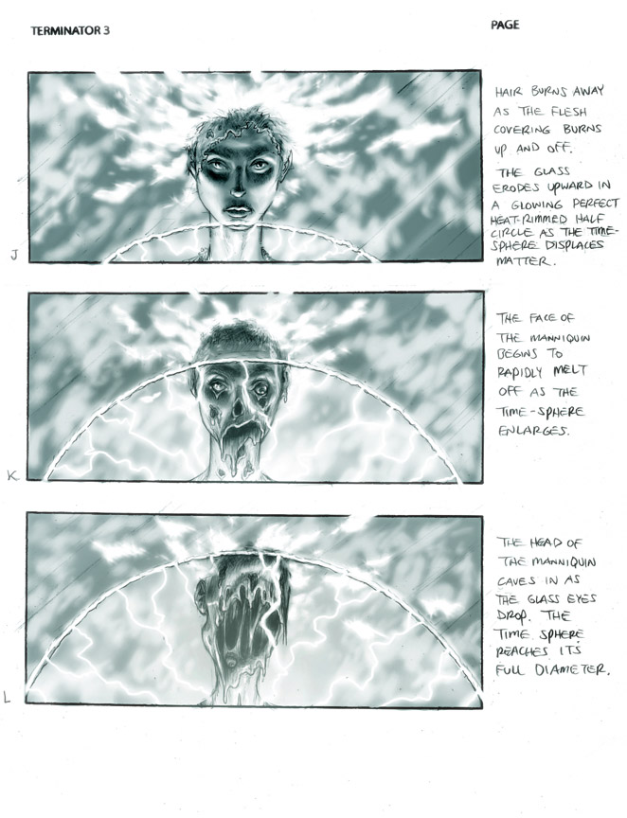
Multi-panel description of a long shot
Narrative indications
From the storyboard for Terminator 3 (shot 21: arrival scene)

Slide 6
Pieces of dialogue
Narrative indication
From the storyboard for Blade Runner

Slide 7
Make the storyboard as explicit and communicative as possible
Clear and simple drawings
(Noel Sickle style)

Slide 8
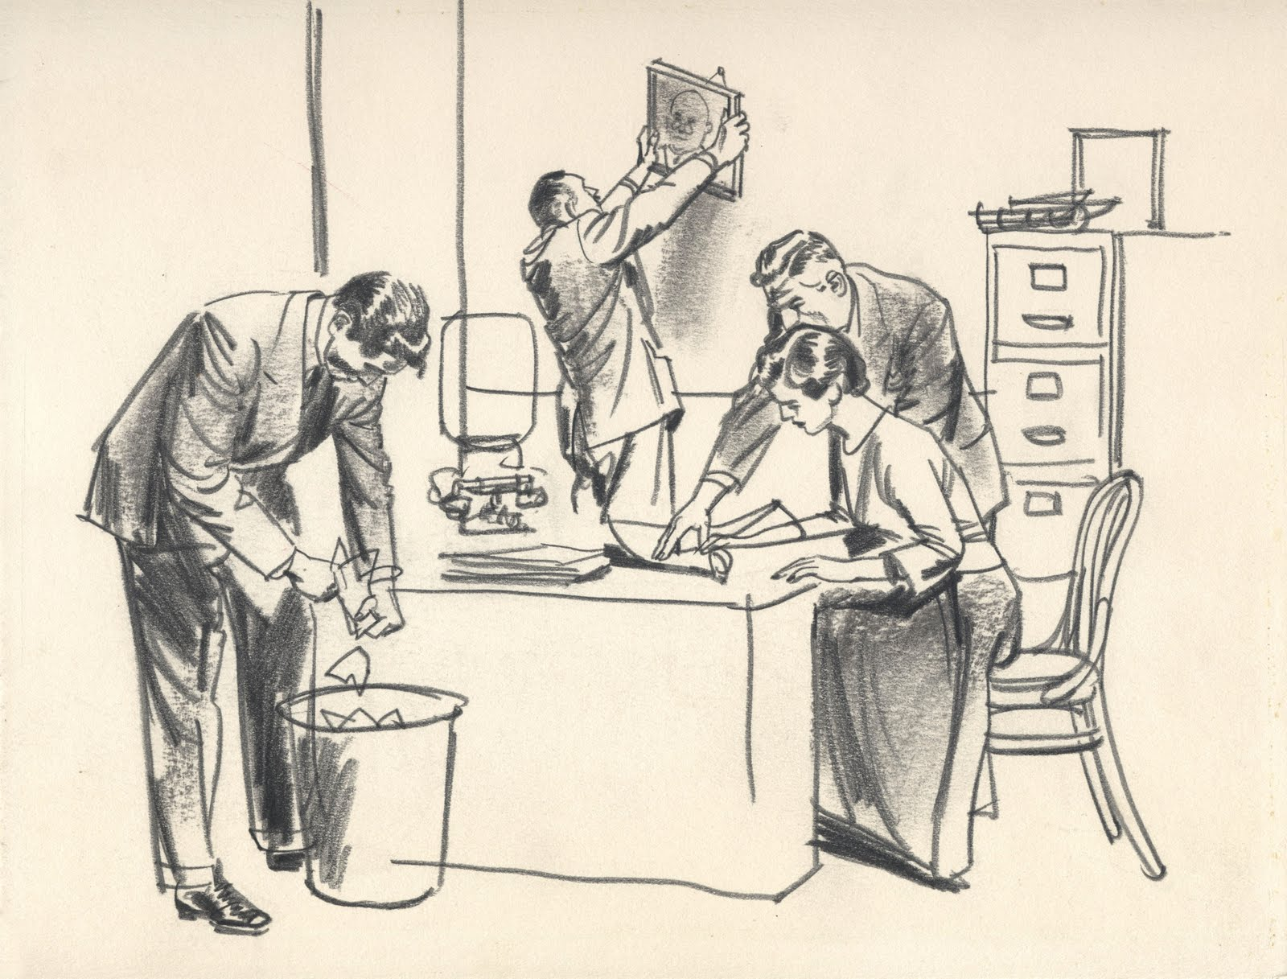
Sickle’s minimalist style : a model for storyboard artists

Slide 9
Storyboards are the opposite of comics
A means
(a visualization tool)
An end in itself (a work of art)

Slide 10
II. What is it for?
Storyboarding is an essential part of the creation process: it helps figures out the cinematic language of a shot, a scene, a sequence, or a whole film.
It answers the question “What is the most visually effective way of expressing the ideas of the screenplay?”

Slide 11
A suggested direction
+
A blueprint for editing
A storyboard brings out the visual continuity of a scene

Slide 12
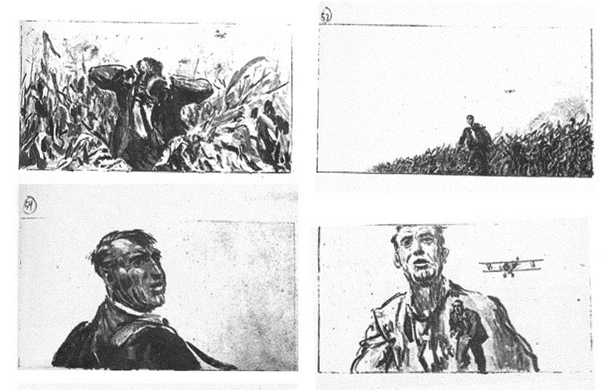
Looking for the right cut: what’s new?
Thornhill runs for his life through a cornfield
Cut/New info: T. gets out; he is exposed
Cut/New info: T. is panick-stricken
Cut/New info: the plane is nosediving on T.
From the storyboard for North by Northwest (1959)

Slide 13
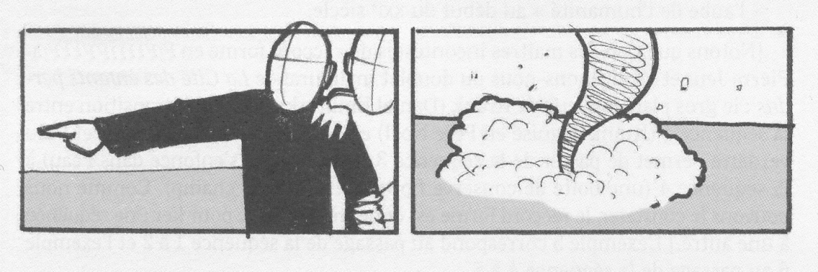
Continuity editing: three basic rules to play by
Make sure that consecutive shots of the same action are linked by
or a screen-direction match
or an eye-line match
a match on action
(For consecutive shots of the same subject)
Note: “the line of vision”: a key element for both the composition of the panel and the dramatic information it conveys.
All the illustrations are from Le Guide pratique du storyboard, Scope éditions, p. 62

Slide 14
Continuity editing: three basic rules to play by
2. Respect the 180-degree rule
Two characters in the same scene should always have the same left/right relationship to each other
Illustrations: ibid.

Slide 15
Continuity editing: three basic rules to play by
3. The 30-degree rule:
the camera should move at least 30° between consecutive shots of the same subject. This change of perspective makes the shots different enough to avoid a jump cut.

Slide 16
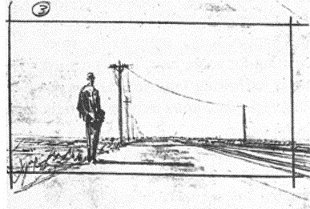
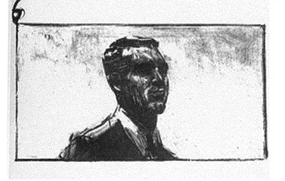
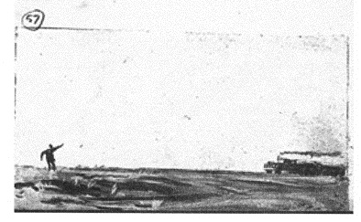
Storyboards contain more technical information than screenplays
Camera distance
Long shot
Medium close-up
Extreme long shot

Slide 17
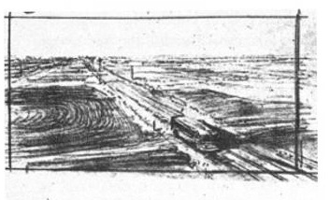
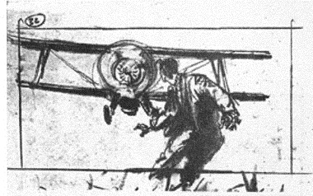
Storyboards contain more technical information than screenplays
Camera angles
High-angle shot
Low-angle shot

Slide 18
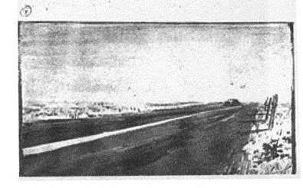
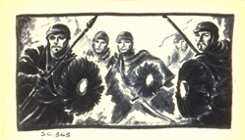
Storyboards contain more technical information than screenplays
Depth of field
Long DOF
(always draw in perspective)
Short DOF
From the storyboard for Sodom and Gomorrah (R. Adlrich, 1962)

Slide 19
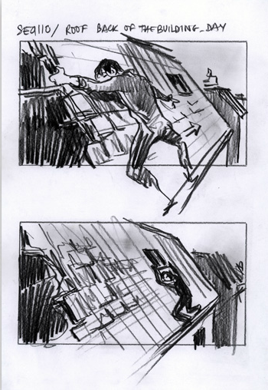
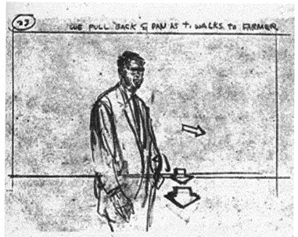
Storyboards contain more technical information than screenplays
Camera and character movements
Character movements are indicated by arrows drawn inside the frame
“We pull back and pan as T. walks to farmer”
Camera movements are indicated by arrows drawn in perspective on the lower edge, or on the side of the frame, and by verbal indications.
From the storyboard for
The Pianist (R. Polanski, 2001)

Slide 20
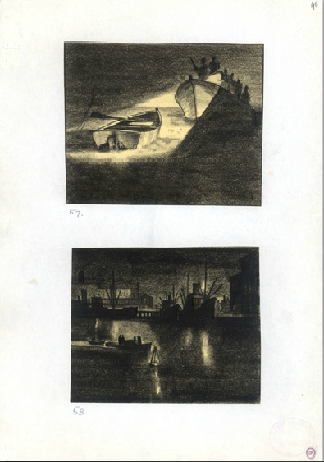
Storyboards contain more technical information than screenplays
Lighting
(when it plays an important dramatic role)
From the storyboard for Man Hunt
Fritz Lang (1941)

Slide 21
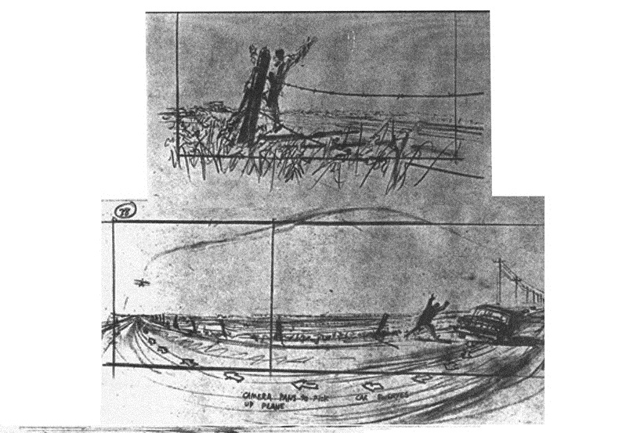
Storyboards contain more technical information than screenplays
What kind of setting, what spatial layout does this scene, this action, this idea require?

Slide 22
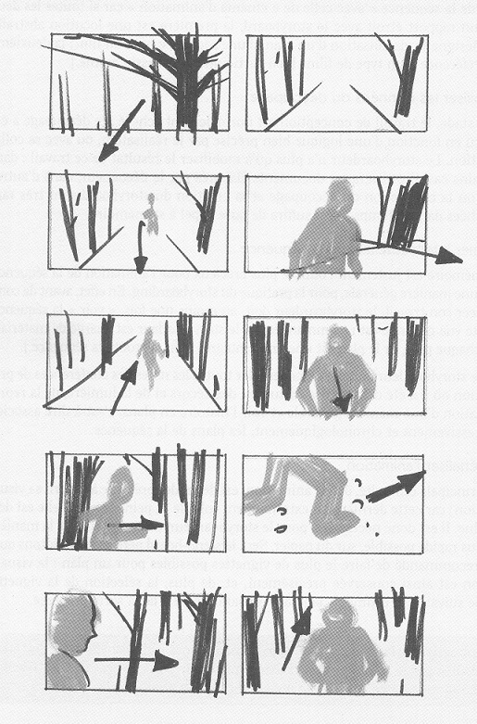
III. How to
Visualize each scene: capture its continuity, its dramatic information, its rhythm.
Capture this on paper as quickly as possible: draw a very sketchy first-draft storyboard.
From Le Guide pratique du storyboard,
op.cit., p.86.

Slide 23
For a complex shot (i.e. a shot with a movement inside the frame and/or a camera movement and/or a change of the focal length), draw at least 3 panels: one for the beginning of the shot (a), one for the middle (b), and one for the end of the shot (c).
a b c
Illustrations from Le Guide pratique du Storyboard, op. cit., p. 88.

Slide 24
Final draft
Each panel must contain 3 elements:
Perspective
Live action (movement)
Story concept (dramatic information of the shot)
Use 13×7cm panels. 2 panels per page.

Slide 25
IV. It’s alive!
Turn your storyboard into an animatic
a series of still images from the storyboard, edited together, and displayed in sequence to suggest the rhythm of the whole scene/sequence

Slide 26
A Simple Animatic
Adapted from a storyboard by Maxime Rebière
(for Chanel n°5)

Slide 49
For more information on storyboarding visit the French Cinémathèque website at
http://www.cinematheque.fr/expositions-virtuelles/storyboard/index.htm

